Slide 1
Secure State Migration in the Data Plane
Jiarong Xing, Ang Chen, T.S. Eugene Ng
Rice University

Slide 2
The network is becoming programmable
Switch control plane
PCIe bus
Memory
ALU
Match/
Action
Table
Match/
Action
Table
Stages
Stages
Match/
Action
Table
Programmable data planes (PDPs)
Can be programmed in high-level languages (e.g., P4)
Support customized protocols and match/actions, persistent state
Run at linespeed (Tbps)

Slide 3
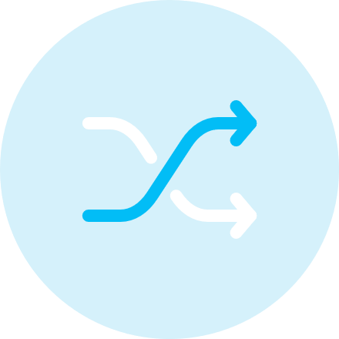
Distributed PDP systems
Load balancers
Hula-SOSR’16
Performance-aware routing
Contra-NSDI’20
Link-flooding defenses
FastFlex-HotNets’19
Distributed systems require state synchronization
Hula: Link utilization → Least utilized paths
Contra: Policy defined metrics → Best routes
FastFlex: Suspicious IPs → Drop or reroute traffic

Slide 4
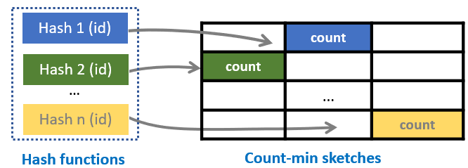
Problem: Secure state synchronization
Source
Destination
untrusted
Copy data from the source to the destination periodically
Data can be in different shapes
The network is untrusted

Slide 5
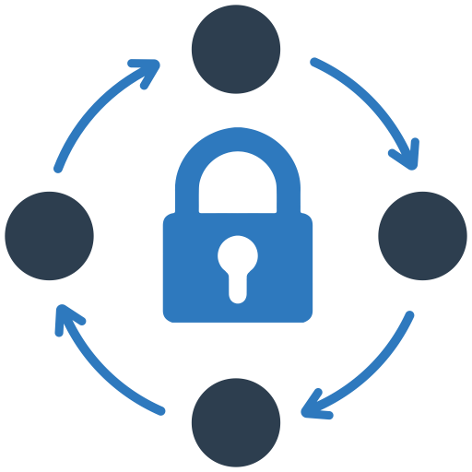
Three key goals
Completeness
Copying data from the source to the destination completely.
Low overhead
Do not utilize too much switch memory and link bandwidth.
Integrity guarantee
The data cannot be modified or spoofed by attackers.

Slide 6
State of the art: Swing State (SOSR’17)
Normal traffic
Register array
Clone
Normal destination
Migration destination
Completeness: Depends on normal traffic pattern
Overhead: Has high traffic overhead.
Integrity: No integrity guarantee.

Slide 7
Can we design a data plane synchronization protocol that satisfies all three goals?
P4Sync

Slide 8
P4Sync overview
Data plane protocol
Completeness
Runs in the data plane with minimal local control plane involvement
Scans and copies the register array end to end
P4Sync
Low overhead
Integrity guarantee
Caches and aggregates dirty data in a delta array
Per-packet MAC and periodic RSA signatures

Slide 9
Outline
Motivation: Data plane state synchronization
State of the art: Cannot satisfy all three goals
Approach: P4Sync
P4Sync design
Challenge #1: Achieving completeness with low overhead
Challenge #2: Data integrity guarantee
Evaluation
Conclusion

Slide 10
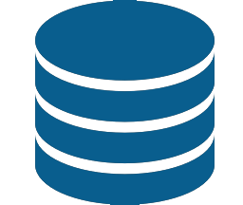
Challenge #1: Achieving completeness with low overhead
Scanning register arrays
Caching new updates
Solution:
Scanning register arrays end to end
Caching and aggregating new updates in a delta array

Slide 11
Scanning register arrays end to end
0
1
2
3
4
…
98
100
Register array
Scanning direction
Rate control
Traffic generator
Migration destination
Using the traffic generator in programmable switches
Controlling the synchronization to a reasonable rate
Maintaining a progress index

Slide 12
Caching and aggregating dirty data in a delta array
Normal traffic
0
1
2
3
4
…
98
100
Register array
0
1
2
3
4
…
98
100
Delta array
Rate control
Traffic generator
Migration destination
Caching and aggregating dirty data in a delta array
Scanning through the delta array at the end

Slide 13
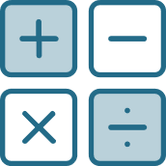
Challenge #2: Data integrity guarantee
Limited arithmetic operations
Software speed
Naïve Solution: Signing every packet with RSA.
In the data plane: Only support limited arithmetic operations
In the control plane: Cannot handle Tbps traffic.
Our solution: Amortizing overhead over a set of packets
Inspired by stream authentication: EMSS (S&P’00)

Slide 14
Amortizing overhead over a set of packets
MAC
MAC
MAC
MAC
MAC
MAC
MAC
…
RSA
RSA
117
116
115
114
113
112
111
Packet header fields
hash(i) = hash(PH, hash(i − 1))
Hash of this packet
Hash of last packet
Building a hash chain in the data plane.
Signing packets in batch in the control plane.
How to handle packet loss and reordering?

Slide 15
Outline
Motivation: Data plane state synchronization
State of the art: Cannot satisfy all three goals
Approach: P4Sync
P4Sync design
Challenge #1: Achieving completeness with low overhead
Challenge #2: Data integrity guarantee
Evaluation
Conclusion

Slide 16
Experimental setup
Proof-of-concept prototype:
Runs in Mininet + P4 bmv2.
Measured RSA speed in a Wedge 100BF-32X Tofino switch
Scenario:
A source switch transmits a hash array to a destination switch.
The attacker in the middle tries to modify the data.
Baseline:
Swing State (SOSR’17)

Slide 17
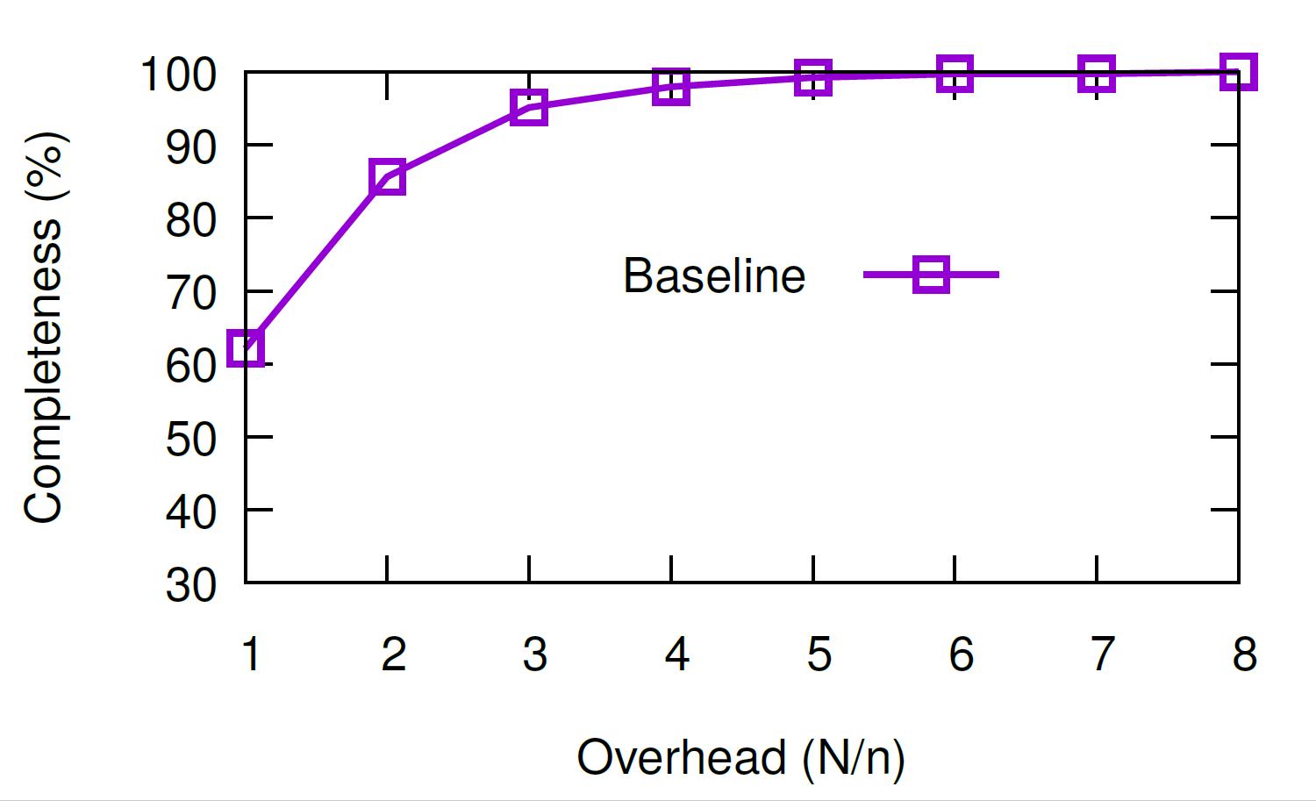
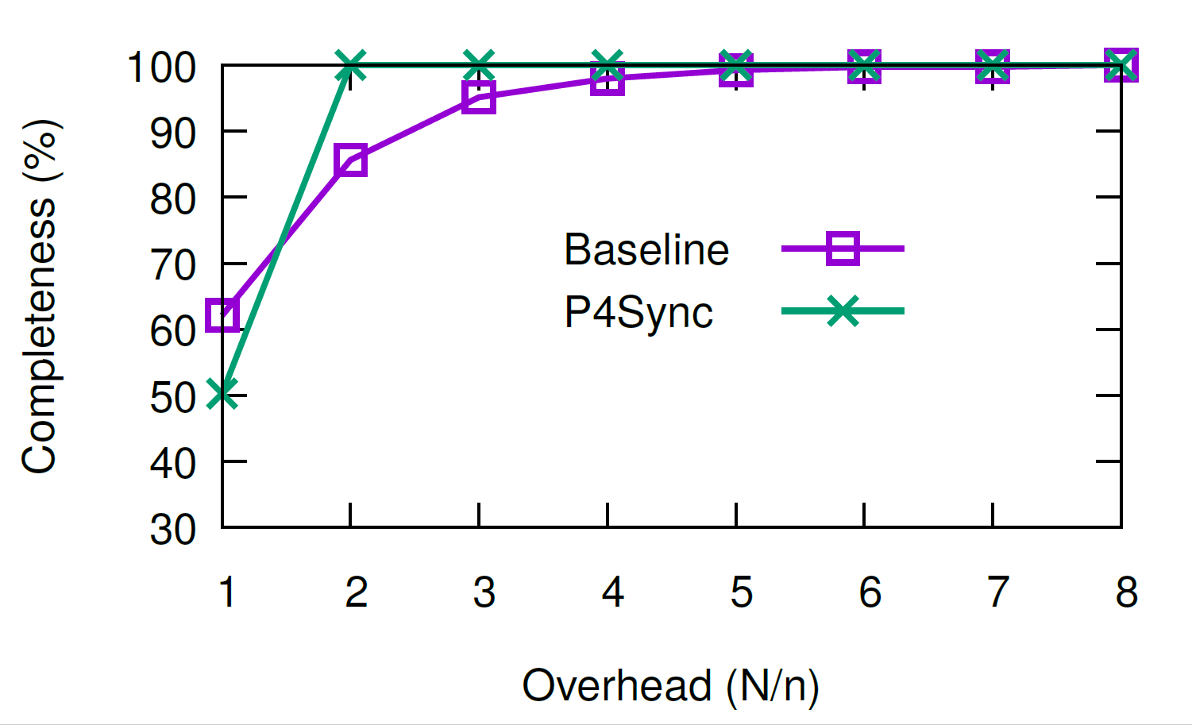
How much traffic overhead does P4Sync incur?
Swing State achieves 100% completeness when overhead is 8.
P4Sync achieves 100% completeness when overhead is 2.
P4Sync can transmit data completely with low traffic overhead.
17

Slide 18
How well can P4Sync defend against integrity attacks?
Source
Destination
trusted
trusted
P4Sync can always detect the packet modification.
RSA-2048: 2.15ms for signature; 0.07ms for verification.
P4Sync can defend against integrity attacks effectively and efficiently!
18

Slide 19
Outline
Motivation: Data plane state synchronization
State of the art: Cannot satisfy all three goals
Approach: P4Sync
P4Sync design
Challenge #1: Achieving completeness with low overhead
Challenge #2: Data integrity guarantee
Evaluation
Conclusion

Slide 20
P4Sync overview
Data plane protocol
Completeness
Runs in the data plane with minimal local control plane involvement
Scans and copies the register array end to end
P4Sync
Low overhead
Integrity guarantee
Caches and aggregates dirty data in a delta array
Per-packet MAC and periodic RSA signatures

Slide 21
Conclusion
Motivation: Data plane state synchronization
Three key goals:
Completeness
Low overhead
Integrity guarantee
Our approach: P4Sync
Scans and copies the register array end to end
Caches and aggregates dirty data in a delta array
Per-packet MAC and periodic RSA signatures
Source code: https://github.com/jiarong0907/P4Sync
Looking for internship in 2021 summer!
Questions?
21

